Slide 1
Comparative Analysis of Depreciation Methods: Straight-Line vs. Diminishing Balance
Sections: Introduction, Key Findings, Actionable, Methodologies , Approaches, Insights, Conclusions

Slide 2
INTRODUCTION
Title: "Comparative Analysis of Depreciation Methods: Straight-Line vs. Diminishing Balance
Depreciation is the systematic allocation of the cost of a tangible asset over its useful life. It reflects the reduction in value of an asset as it is used over time
Importance of Depreciation in Accounting: Depreciation helps in matching the cost of the asset with the revenue it generates. It provides a method to allocate the cost of the asset over its useful life, impacting both the income statement and the balance sheet. Depreciation also helps in tax deduction, as it is considered an expense.

Slide 3
Depreciation Method’s
Straight-Line Method
Diminishing Balance Method
Calculation Formula: Depreciation per year = (Asset Price - Scrap Value) / Estimated Life Span
Calculation Formula: Depreciation per year = Book Value at Beginning of Year * Depreciation Rate.

Slide 4
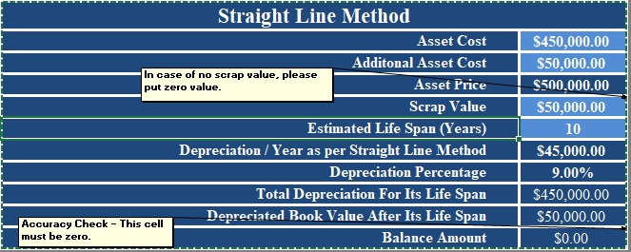
Key Findings
Straight-Line Method
Calculated the annual depreciation amount using the straight
-line method where the total depreciation is = $450,000

Slide 5
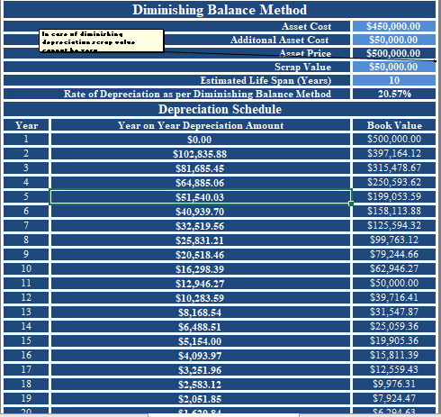
Key Findings
Diminishing Balance Method
Calculated the annual depreciation amount
using the diminishing balance method and
with the book value for next 20 years where
the total depreciation is $450,000.

Slide 6
Method & Actionable’s
In the straight- line method , the asset’s value is depreciated evenly over its useful life. The formula for calculating straight- line method
Annual Depreciation = (Asset Price - Scrap Value) / Estimated Life Span
This calculation part is completed within 3 steps :-
Step 1 : Input the values in the formula
Step 2 : Use the formula Ex: = ($500,000 - $50,000) / 10 ={$45,000}
Step 3 : Then, Total Depreciation = Annual Depreciation * Estimated Life Span i.e = $45,000 * 10 ={$450,000}
Key point : Consistent depreciation every year.

Slide 7
Method & Actionable’s
In the diminishing balance method, depreciation is calculated based on a fixed percentage of the asset’s value at the beginning of each period. It results in large depreciation in the earlier years and smaller depreciation in the later years.
Depreciation = Book Value at Beginning of Year * Rate of Depreciation
Step 1 : Input the values in the formula
Step 2 : Required: Year, Beginning of book value, Depreciation and Ending book value
Step 3 : Using Depreciation of year formula = $500,000 * 20.57% = {$102,835.88}
Step 4 : Ending of book value : Beginning of book value – Depreciation of year i.e = $500,000 - $ 102,835.88 = {$397164.1}
Step 5 : In subsequent years, the beginning value for each year is the ending book value from the previous year.
Key point : Depreciation decreases each year as the asset value decreases.

Slide 8
Approaches
Straight Line: Depreciation is consistent every year , we can just apply the same formula each year
Diminishing balance: Depreciation is calculated based on the book value ,which changes each year, requiring a dynamic formula that adjusts as the book value decrease.

Slide 9
Straight-Line Depreciation Insights
Consistency: Provides stable, predictable depreciation expenses every year, simplifying budgeting and forecasting.
Simplicity: Easy to calculate and understand, with a fixed annual expense.
Tax Impact: Equal tax deductions each year, which makes it easier for businesses to plan for taxes.
Best for Long-Term Assets: Ideal for assets with a consistent value over time, such as buildings or furniture.
Longer Financial Stability: Depreciation spreads evenly, helping businesses plan for long-term financial stability.

Slide 10
Diminishing Balance Depreciation Insights:
Higher Early Depreciation: Larger depreciation expenses in the earlier years, reducing taxable income and improving cash flow in the short term.
Reflects Asset Usage: More accurate for assets that lose value quickly, such as vehicles or technology.
Declining Depreciation: Depreciation decreases over time as the book value reduces, matching the asset’s decreasing utility.
Tax Deferral: Provides immediate tax benefits by accelerating depreciation, which is useful for businesses needing short-term tax relief.
Complexity: Requires more detailed calculations as it involves tracking the asset’s declining book value each year.

Slide 11
Conclusion
Straight line is better for long-term , stable assets with predictable usage.
Diminishing balance is better for assets with rapid depreciation or those that lose value quickly in the early years.
Ultimately, the “better” method depends on our financial strategy, the nature of the asset, and the tax implications for business . Many companies use the straight- line method for simplicity in financial reporting but may choose the diminishing balance method for tax advantages, particularly in the case of high-value or rapidly depreciating assets.

Slide 12
Prepared by:- E Sweta Rao

